Slide 1
Stock Synthesis 3
An introduction

Slide 2
What is Stock Synthesis
Integrated analysis
Includes multiple sources of data and error
First written in FORTRAN in 1980s
Originally developed for northern anchovy
Now widely used for stock management advice all over the world

Slide 3
1984 - Northern Anchovy
Age composition data
Aging errors
Low fishing mortality
Triennial egg and larval survey
Time-varying fishery selectivity
Ocean temperature effects on age-specific maturity
Time-varying natural mortality as function of predator abundance

Slide 4
1988 - Sablefish
Big problem with aging error
Introduced aging error matrix
Both size- and age-selectivity
Ability to estimate growth params while accounting for effects of size selectivity and aging imprecision

Slide 5
1988 - Pacific Hake
20 years of complete age-comp data from fisheries and surveys
Multiple stock areas with annually varying proportion of the stock in each area
In response to fluctuations in abundance from El Niño and La Niña

Slide 6
SS2 and SS3
2005 – model translated from FORTRAN to ADMB
2009 – reworked internal structures
Current version: 3.30.12 – 3.30_beta version released in 2016, updated from 3.24

Slide 7

Stock Synthesis Usage
hake, about 20 groundfish species
cod, flatfish
groundfish,
surfclam
tuna
more groundfish
shrimp
grouper,
menhaden
tuna, marlin
anglerfish, sardine, hake
tuna, sharks, small pelagics
mackerel, tuna
tuna, sharks
tuna
snapper
Many stocks in Chile & Argentina
sharks, toothfish, various strange Australian fish
Slide from Rick Methot

Slide 8
Brief overview of features

Slide 9
Stock Synthesis Structure
NUMBERS-AT-AGE
Cohorts: gender, birth season, growth pattern;
“Morphs” can be nested within cohorts to achieve size-survivorship;
Distributed among areas
AREA
Age-specific movement between areas
FLEET / SURVEY
Length-, age-, gender selectivity
CATCH
F to match observed catch;
Catch partitioned into retained and discarded, with discard mortality
RECRUITMENT
Expected recruitment is a function of total female spawning biomass;
Optional environmental input;
apportioned among cohorts and morphs;
Forecast recruitments are estimated, so get variance
PARAMETERS
Can have prior/penalty;
Time-vary as time blocks, random annual deviations, or a function of input environmental data
Slide from Rick Methot
Notes:
9
So, let me recap SS2 structural features

Slide 10
Stock Synthesis Data
Retained catch
CPUE and survey abundance
Age composition
Within length range
Size composition
By biomass or numbers
Within gender and discard/retained
Weight bins or length bins
Mean length-at-age
Discard (% or total)
Mean body weight
Tag-recapture
Stock composition
Slide from Rick Methot
Notes:
10

Slide 11
Stock Structure
Year-class or cohort
Tracks numbers-at-age for each entity
Divided into biological (e.g. gender, growth, M) or birth season morphs
Divided into males and females with gender-specific growth and M
Divided into slow-, medium-, and fast-growing platoons
Each platoon can have unique age-specific mortality and survivorship
Based on platoon-specific size-at-age distribution

Slide 12
Spawner-Recruitment
Beverton-Holt
Ricker
Hockey Stick
3 parameter survivorship-based function
3 parameter Shephard stock-recruitment
Outputs expected mean number of age-0 animals
In multi-area model, reproductive potential is summed over all areas
Lognormal recruitment deviations with bias adjustment ramp
Can be distributed over multiple seasons depending on spawning events

Slide 13
Weight-at-Age
Calculate body weight-at-age from a length-at-age growth function based on parameters, body weight-at-length function, and size selectivity of the fishery
Mean body weight at true age
Option to input empirical body weight-at-age observations

Slide 14
Length-at-age
Typically von Bertalanffy, using Schnute reparameterization
Size at two reference ages- linear growth assumed below the lower reference age
3 parameter Richards growth function
Can incorporate time-varying growth parameters
Fish cannot shrink in length
Cohort-specific growth rate, but not cohort-specific asymptotic size
Can invoke age-specific growth rates

Slide 15
Selectivity
Age-, size-, and gender-selectivity options for each fishing fleet and survey
Simple logistic
Mirror
Non-parametric
Double logistic
Random walk
Double normal

Slide 16
Examples of SS in Use

Slide 17
Stock Assessments
hake, about 20 groundfish species
cod, flatfish
groundfish,
surfclam
tuna
more groundfish
shrimp
grouper,
menhaden
tuna, marlin
anglerfish, sardine, hake
tuna, sharks, small pelagics
mackerel, tuna
tuna, sharks
tuna
snapper
Many stocks in Chile & Argentina
sharks, toothfish, various strange Australian fish

Slide 18

ss3sim

Slide 19
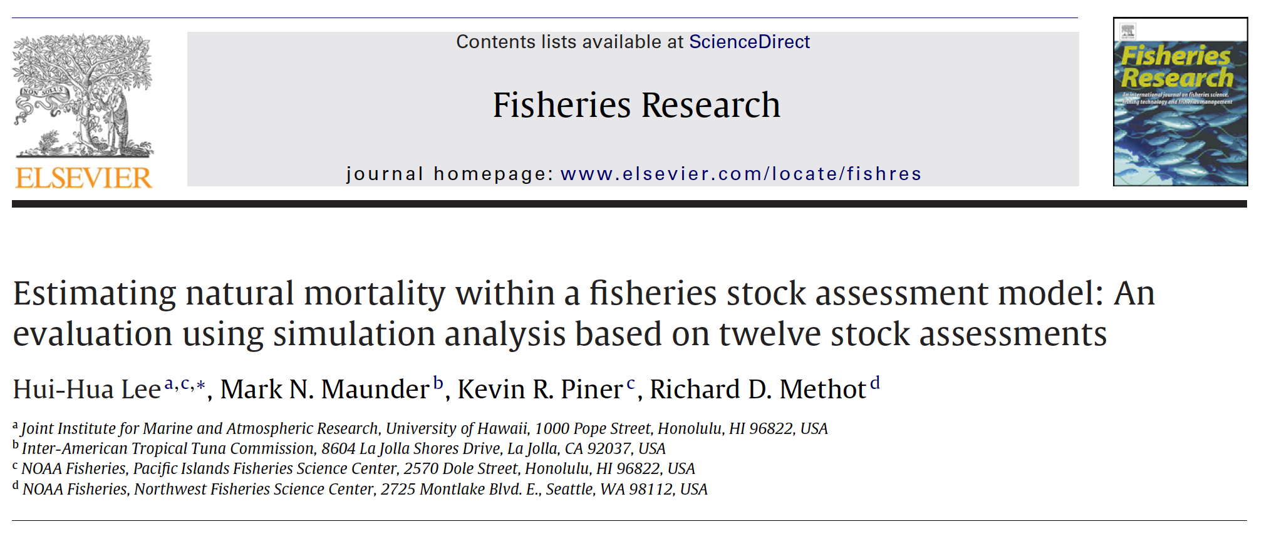



Time-varying Parameters
Notes:
Easy to do meta-analysis

Slide 20
Benefits of using Stock Synthesis
Bugs less likely to escape notice
Easier comparison with other models
E.g. for meta analysis, testing model assumptions
Standardised diagnostics and model output
Flexible options for population processes
Slide adapted from Rick Methot

Slide 21
Risks of using Stock Synthesis
“Black box” model
Additional features might take a while to get implemented
Might be technically challenging to debug

Slide 22
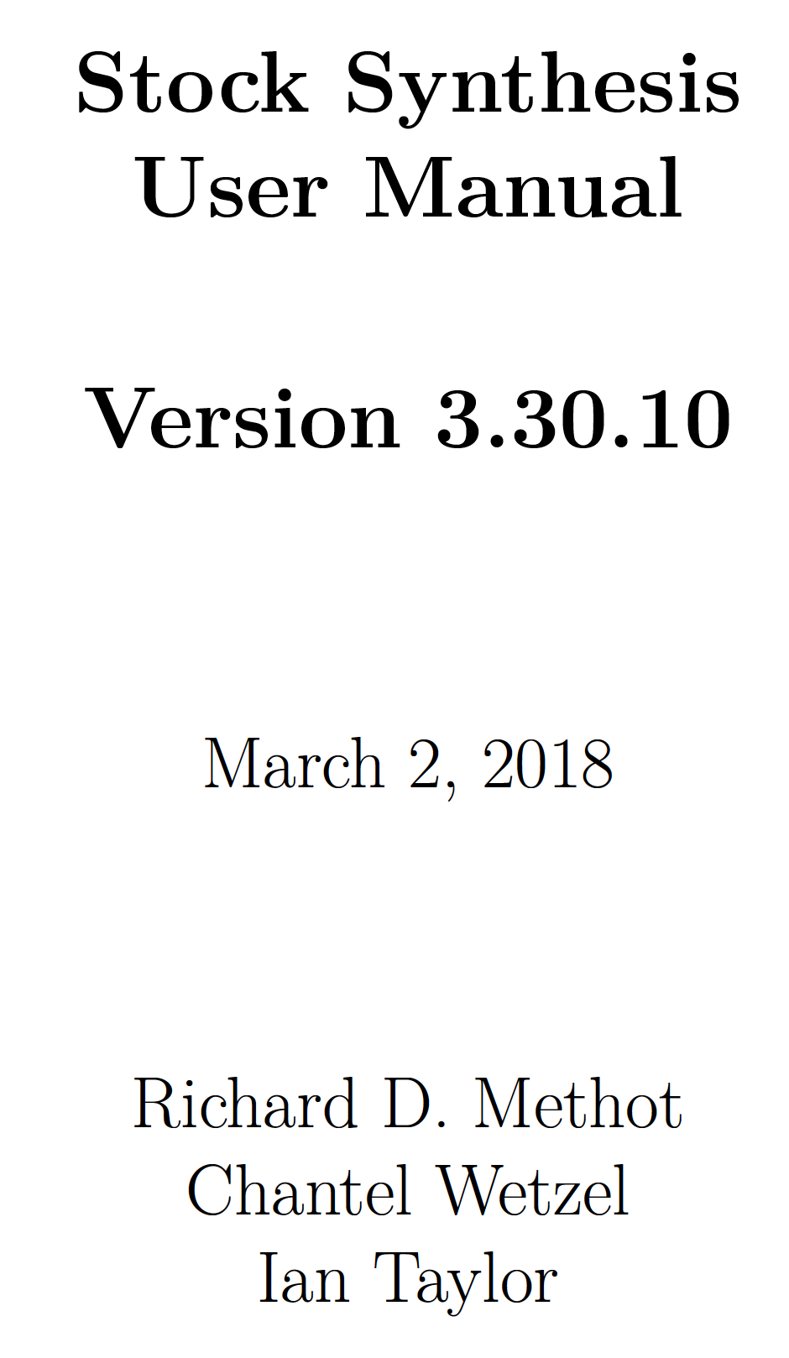

More Information
https://vlab.ncep.noaa.gov/group/guest

